Slide 1
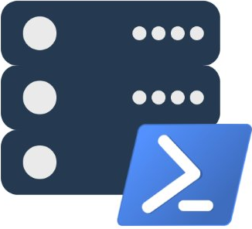
dbatools ❤ SQL Server
Presented by
Chrissy LeMaire, MVP
chrissy lemaire, mvp: netnerds.net, @cl code: dbatools.io

Slide 2
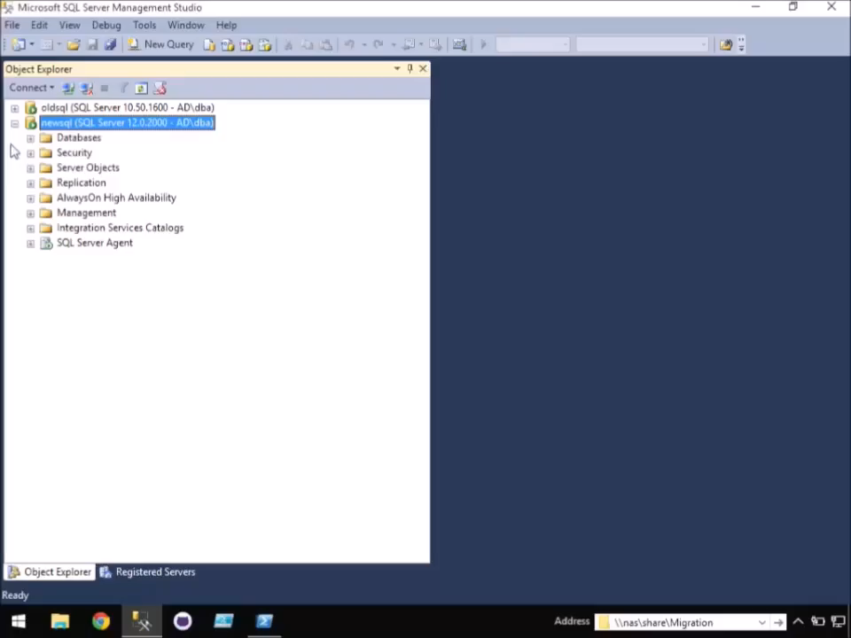
-WhatIf SQL Server Migrations went more like this…
dbatools.io | dbareports.io | sqlps.io | sqlps.io/slack | dbatools.io/youtube

Slide 3

Cloud & DataCenter (PowerShell)
2015, 2016, 207
chrissy lemaire, mvp: netnerds.net, @cl code: dbatools.io

Slide 4


DBA at NATO Special Ops HQ
chrissy lemaire, mvp: netnerds.net, @cl code: dbatools.io

Slide 5

chrissy lemaire, mvp: netnerds.net, @cl code: dbatools.io

Slide 6

twitter
@cl
chrissy lemaire, mvp: netnerds.net, @cl code: dbatools.io
Notes:
Community project, initially started out as Start-SqlMigration but has grown into a DBA’s best friend. dbatools currently sports 79 commands.
How many of you have heard of dbatools? How many of you have used it? How many knew it was born in Belgium? :D

Slide 7
Agenda - dbatools
Who
Requirements
Hella Demos
1
2
3
4
5
6
Overview
Install
Questions!
chrissy lemaire, mvp: netnerds.net, @cl code: dbatools.io

Slide 8

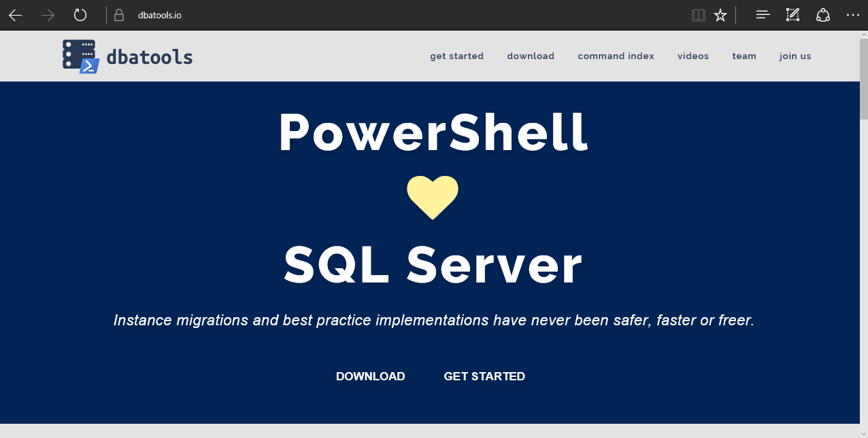
dbatools
chrissy lemaire, mvp: netnerds.net, @cl code: dbatools.io
Notes:
Community project, initially started out as Start-SqlMigration but has grown into a DBA’s best friend. dbatools currently sports 100 commands.
How many of you have heard of dbatools? How many of you have used it?

Slide 9
System Requirements
Minimum
Client
PowerShell v3
SQL Server Management Studio 2008 R2
Server
SQL Server 2000
Recommended
Client
PowerShell v5
SQL Server Management Studio 2012+
Server
SQL Server 2005+
Most dbatools commands do not care about the
version of PowerShell on the server – only client.
chrissy lemaire, mvp: netnerds.net, @cl code: dbatools.io
Notes:
Started as a migration tool, so I strived to support older environments
No reliance on SQLPS, because we’ve got a history ;)

Slide 10
Install is easy
PowerShell Gallery
Install-Module dbatools
Install-Module dbatools –Scope CurrentUser
GitHub – dbatools.io/git
Invoke-Expression (Invoke-WebRequest https://dbatools.io/in)
Clone repo found at dbatools.io/git, Import-Module dbatools
chrissy lemaire, mvp: netnerds.net, @cl code: dbatools.io
Notes:
Gallery requires admin access and is built into PowerShell v5. Other versions also support it with a bit of configuration.
Download
Unzip
Import-Module

Slide 11
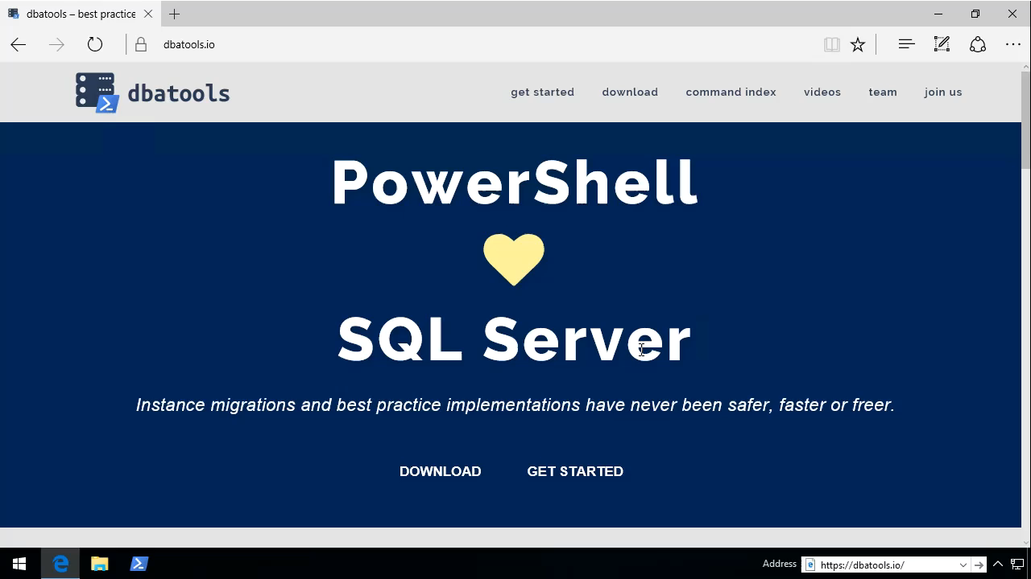
See?
chrissy lemaire, mvp: netnerds.net, @cl code: dbatools.io

Slide 12
Support
We aim for:
SQL Server 2000 – vNext
Express – Datacenter Edition
Clustered and stand-alone instances
Windows and SQL authentication
Default and named instances
Multiple instances on one server
chrissy lemaire, mvp: netnerds.net, @cl code: dbatools.io
Notes:
Gallery requires admin access and is built into PowerShell v5. Other versions also support it with a bit of configuration.
Download
Unzip
Import-Module

Slide 13
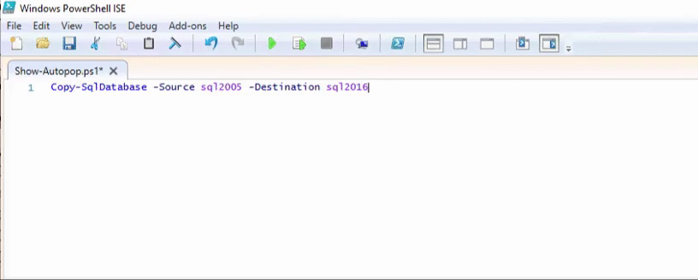
Support
chrissy lemaire, mvp: netnerds.net, @cl code: dbatools.io

Slide 14
Before I begin the demos..
Feature Freeze Coming Soon
March 1 begins a feature freeze, to make way for 1.0
1.0 will be awesome, but will have breaking features
What We’ll Be Doing
Fixing all bugs reported at dbatools.io/issues
Making permissions check more accurate
Standardizing command names, parameter names, help, variables, etc.
Standardizing output – going to all objects and verbose instead of text
Adding more/better pipeline support
Testing, testing, testing
chrissy lemaire, mvp: netnerds.net, @cl code: dbatools.io
Notes:
Gallery requires admin access and is built into PowerShell v5. Other versions also support it with a bit of configuration.
Download
Unzip
Import-Module

Slide 15
Before I begin the demos..
Releases will continue
We will continue to release bug fixes
1.0 will be released on June 1, 2017
Crossing our fingers
chrissy lemaire, mvp: netnerds.net, @cl code: dbatools.io
Notes:
Gallery requires admin access and is built into PowerShell v5. Other versions also support it with a bit of configuration.
Download
Unzip
Import-Module

Slide 16
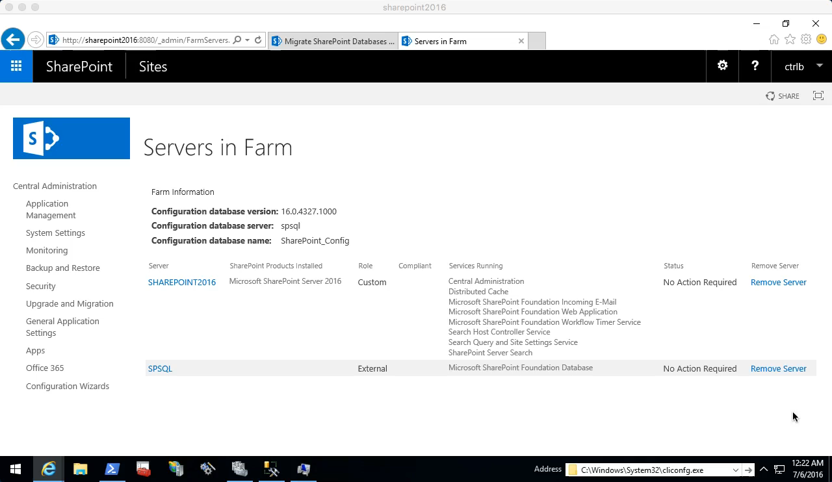
Start-SqlMigration
chrissy lemaire, mvp: netnerds.net, @cl code: dbatools.io

Slide 17

Start-SqlMigration
chrissy lemaire, mvp: netnerds.net, @cl code: dbatools.io

Slide 18
SQL Server Administration and Best Practices
demo
chrissy lemaire, mvp: netnerds.net, @cl code: dbatools.io

Slide 19
How to Get-Help
Extensive documentation within each command Get-Help Start-SqlMigration –Detailed
Extensive documentation on dbatools.io
dbatools.io/Start-SqlMigration
dbatools.io/Repair-SqlOrphanUser
Some commands have videos
dbatools.io/youtube
chrissy lemaire, mvp: netnerds.net, @cl code: dbatools.io

Slide 20
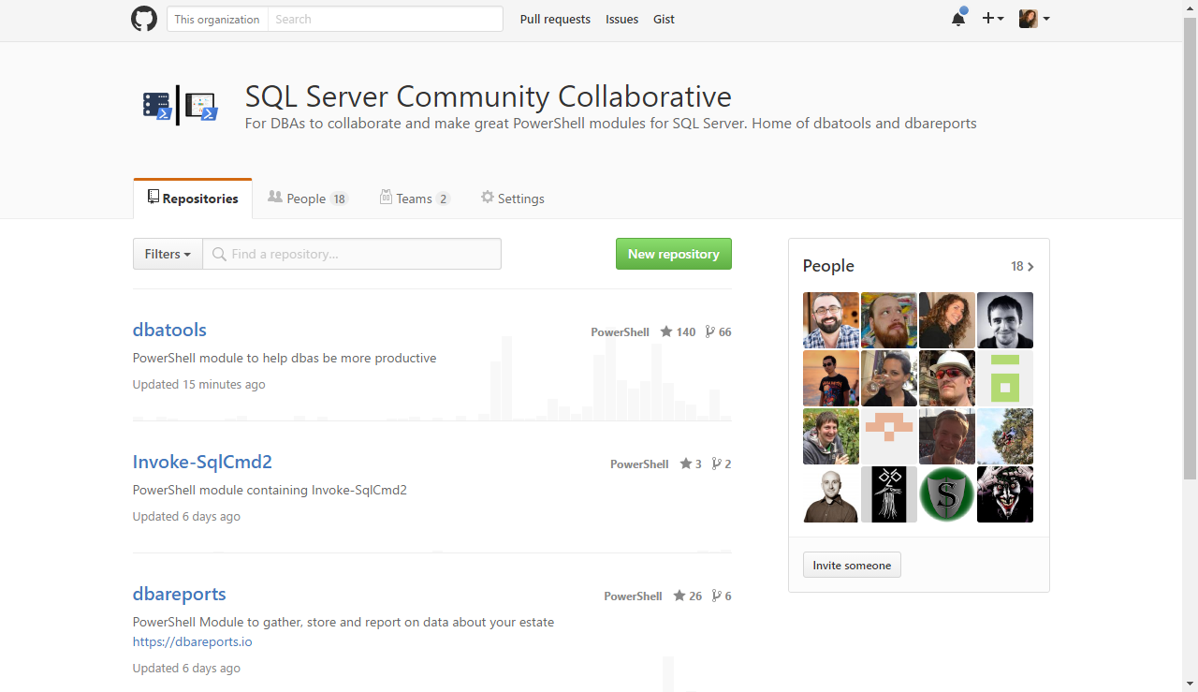
Join us! – github.com/sqlcollaboratve
chrissy lemaire, mvp: netnerds.net, @cl code: dbatools.io

Slide 21
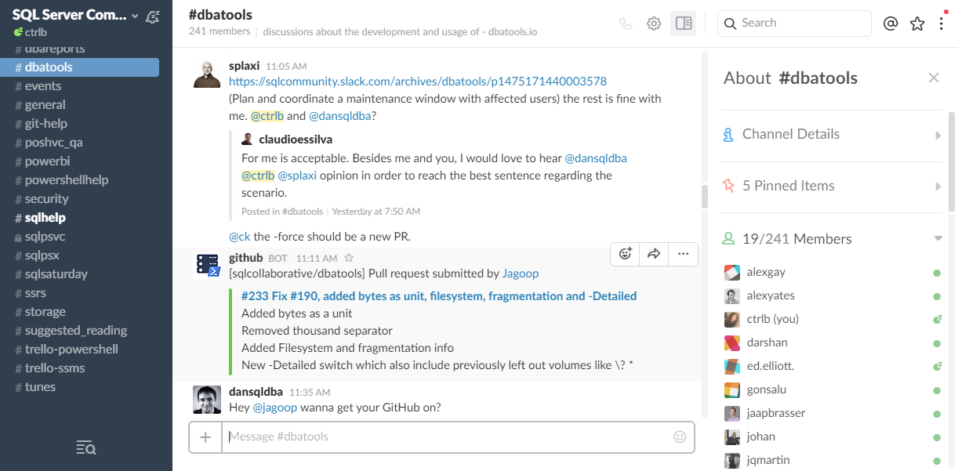
Join us! - dbatools.io/slack
chrissy lemaire, mvp: netnerds.net, @cl code: dbatools.io

Slide 22
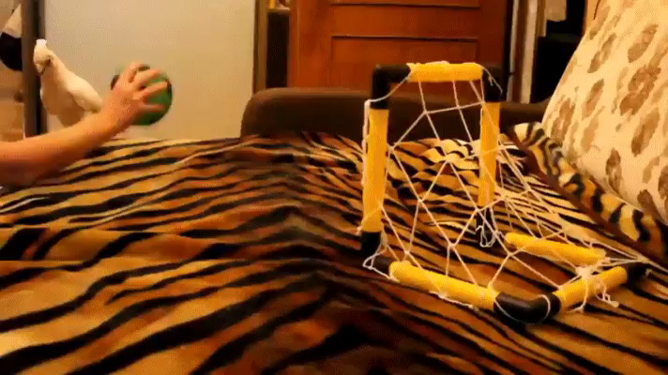
Community got us feelin’ like
chrissy lemaire, mvp: netnerds.net, @cl code: dbatools.io
Notes:
Cut it out.

